Slide 1





Introduction to Python Data Types
Python is a versatile language. It uses different data types to represent various kinds of data. Understanding these data types is crucial for writing effective Python code.
by Manjeet Singh

Slide 2

Numeric Data Types (int, float, complex)
Numeric data types represent numbers. They include integers (int), which are whole numbers, floating-point numbers (float), which have decimal points, and complex numbers (complex), which have both real and imaginary components.
Integers
Floating-Point Numbers
Complex Numbers
Integers are whole numbers. Example: 10, -5, 0.
Complex numbers have real and imaginary components. Example: 2 + 3j, -1 - 4j.
Floating-point numbers have decimal points. Example: 3.14, -2.5, 1.0.

Slide 3

Boolean Data Type
The Boolean data type represents truth values. It can have only two values: True or False.
1
True
2
False
Represents a true value. Example: 1 > 0 is True.
Represents a false value. Example: 1 < 0 is False.

Slide 4
String Data Type
The string data type represents sequences of characters. Strings are enclosed in single quotes, double quotes, or triple quotes.
Single Quotes
Double Quotes
Triple Quotes
'Hello World'
"Hello World"
"""Hello World"""

Slide 5

List Data Type
The list data type represents ordered sequences of items. List items can be of any data type and can be accessed using their index.
Creating a List
Modifying Elements
Lists are created using square brackets and separated by commas.
Elements can be modified by assigning new values to their index.
1
2
3
Accessing Elements
Elements can be accessed using their index, starting from 0.

Slide 6



Tuple Data Type
Tuples are similar to lists but are immutable, meaning their elements cannot be modified after creation.
Creation
Accessing Elements
Tuples are created using parentheses and separated by commas.
Elements can be accessed using their index, starting from 0.

Slide 7
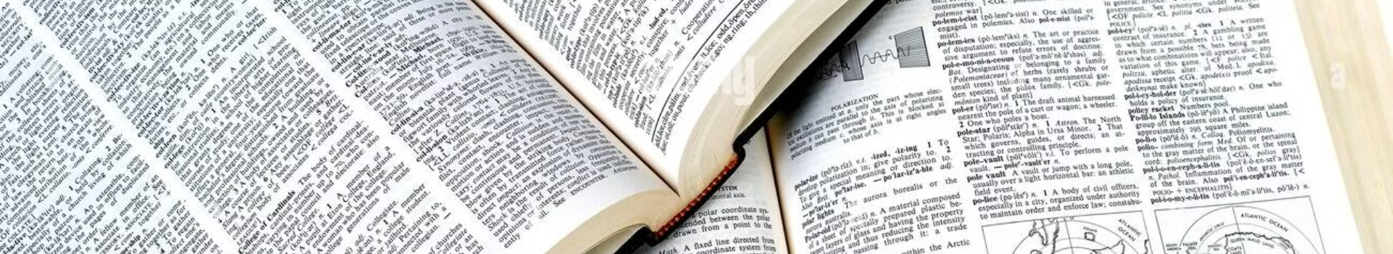
Dictionary Data Type
The dictionary data type represents unordered collections of key-value pairs. Keys are unique and immutable, while values can be of any data type.
Key
Value
"name"
"John"
"age"
30
"city"
"New York"

Slide 8





Set Data Type
The set data type represents unordered collections of unique items. Sets are mutable and support operations like union, intersection, and difference.
Adding Elements
Removing Elements
Union
Intersection
Elements can be added using the add() method.
The union of two sets contains all elements from both sets.
The intersection of two sets contains only elements that are common to both sets.
Elements can be removed using the remove() method.

